Slide 1
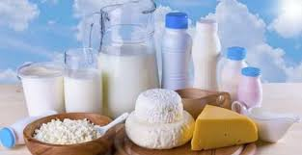
Project on entrepreneurship development of milk industry egra : Purba Medinipur: west Bengal: pin-721456
GUIDED BY:
DR.APURBA GIRI (Assistant Professor and HOD)
AYAN MANDAL (Assistant Professor)
Dept .of Nutrition
Mugberia Gangadhar Mahavidyalaya
PROJECTED BY:
Rabin nanda goswami
B. Voc (Food Processing, 6th sem)
Dept .of Nutrition
Mugberia Gangadhar Mahavidyalaya

Slide 3
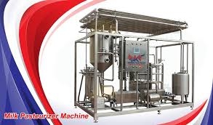
Introduction:
Business is any economic activity that includes the purchase or sale of goods or services with the basic objective of earning profit and satisfying the individuals' needs of the society.
Business activities can be classified into two categories: industry and commerce.

Slide 4
MARKET SURVEY:
You must research to decide exactly what the public is interested in. This will also help you know if the frozen milk business will sustain itself in your region.
One of the keys to success in any business is presuming out what customers desire and how they require it and providing it to them the way they assume is the perfect plan.
During your research, you may explore some fascinating data that will help raise your business.

Slide 5
LOCATION CHOSE:
In order to select the location, you must consider the area where you want to open the sweet curd industry.
You should go to the city, suburban, and rural area but make sure you should choose the pollution free area.
You should also make a rough plan and estimation of your spending. Because sweet card industry requires so much money and investment in order to make the building.
You need more money to buy bricks, cement, and some other things which are necessary to make the building.

Slide 6
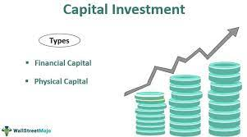
INVESTMENT:
CAPITAL 20-30 LAKHS

Slide 7
LICENCE:
Business Entity
FSSAI registration
Trade License
Udyog Aadhaar Registration
GST Registration
BIS certification
No Objection Certificate From State Pollution Control Board

Slide 8
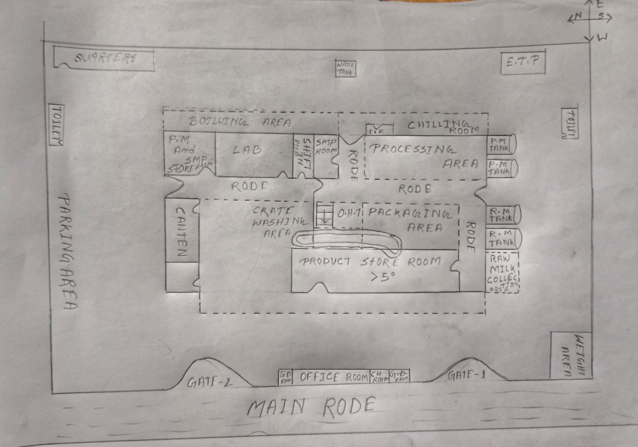
LAYOUT:
.

Slide 9
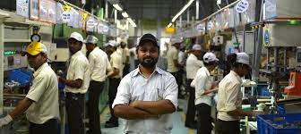
MANPOWER:
Guard- 2
Weighting area-1
Lab-4
Processing-3
Packaging-2
Store-2
Washing-3
Boiler section-2
Chilling section-2
Etp-1
Shift incharge-2
Data documentation-1
Electrician-2
Overall manegment-1

Slide 10
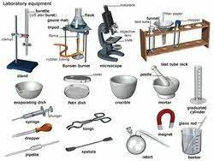
EQUIPMENT:
Milk Storage tank
Motor
Pasteurizer
homogenizer
Pasteurizer holding tube
Packaging machine
Gerber centrifuge
Lactometer
Thermometer
Refrigerator
Weight machine
water bath
Hot air oven
Vat
Venture
Ceram separator
Spatula
Etc.

Slide 11
FLOW CHART:
Sampling, grading, testing
Cooling of milk at 5⁰c
Reception of milk
.
filtration
Preheating
Storage of milk
Preheating
Homogenisation
Pasteurization
packaging
Storage at tanks
Cooling
Store at cold storage
Distribution

Slide 12
LABORATORY TEST:
Platform test
Adulteration test
FAT TEST
CLR TEST
SNF TEST
Ci test
ACIDITY TEST
ALCOHOL TEST
Phosphorate test
MBRT TEST
POUCH QUALITY TEST
Specific gravity calculation

Slide 13
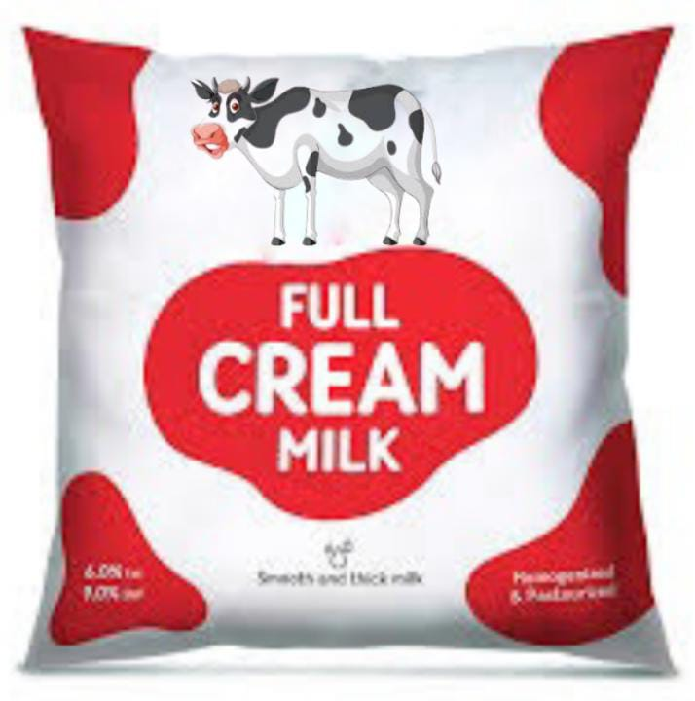
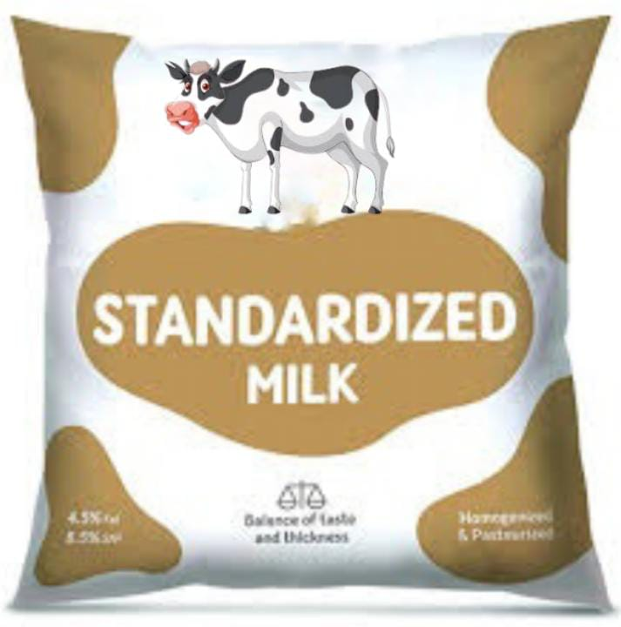
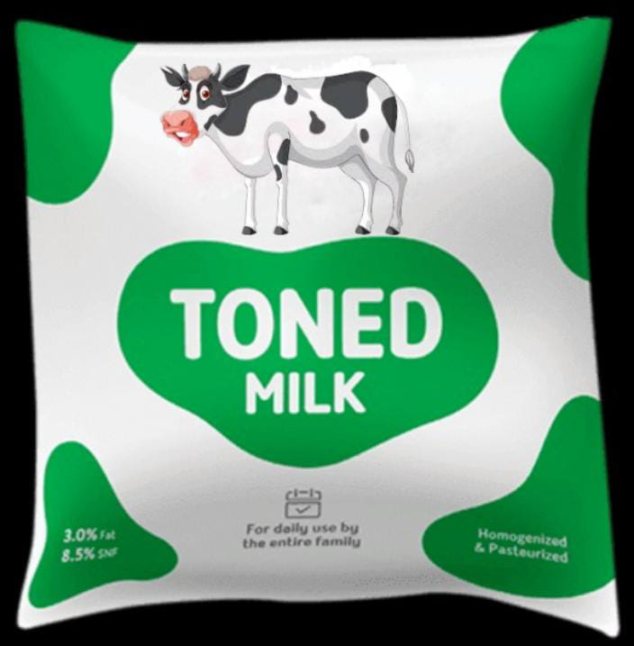
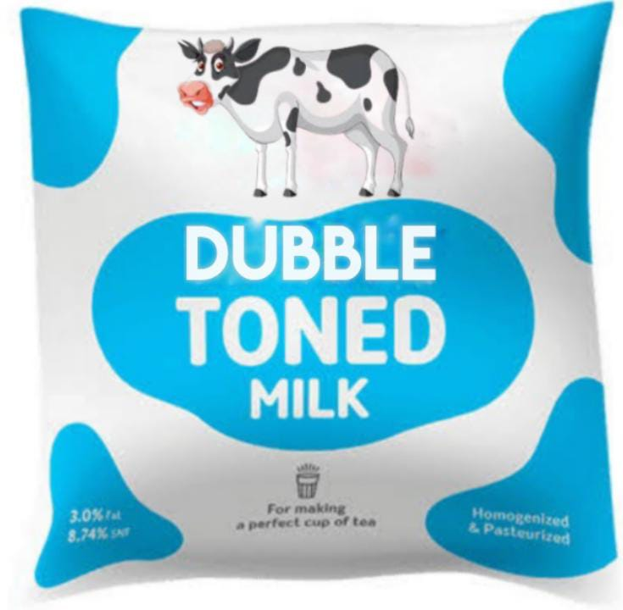
Product details:
.
Product name | Manufacturing cost | Retailer cost | MRP
TM | 17 | 21 | 24
DTM | 14 | 17 | 21
SM | 18 | 22 | 26
FCM | 19 | 23 | 29

Slide 14
BUSINESS RESEARCH:
Demand
Supply
Price
Quality
Quantity

Slide 15
MARKET STRATEGY:
Publicity
Advertising
Sales promotion
Direct marketing
Special discount

Slide 16
TARGET COUSTOMER BEING:
Sweets shops
Hotels and restaurants
Marriage and functions
Wholesalers
Tea shop

Slide 17
CONCLUSION:
A business plan conclusion is a summary of a business plan's strengths designed to convince the reader of the company's success.
Because companies typically create business plans to get funding or investors, the conclusion should focus on how the organization makes money and why it is a good investment.

Slide 18
THANK YOU

